Slide 1

TEAM NAME: THE PY-SQUAD PROJECT ID: SPS_PRO_1742 TEAM MEMBERS: PRABHU U NIRMITHA S KAVIYA S S SRI RAJESWARI S
SENTIMENT ANALYSIS OF COVID-19 TWEETS
College Name: R.M.K ENGINEERING COLLEGE
CHENNAI, TAMILNADU

Slide 2
TABLE OF CONTENTS
General Description
Novelty / Uniqueness
Business / Socio Impact
Technology Stack
Scope
Problem Statement

Slide 3

Problem Statement
The sentiment analysis of Indians after the extension of lockdown announcements to be analyzed with the relevant #tags on twitter and build a predictive analytics model to understand the behavior of people.
Develop a dashboard with visualization of people reaction to the government announcements

Slide 4





GENERAL DESCRIPTION
The proposed solution is to construct a python code using packages such NLKT and other machine learning packages that would refine the tweets and used to predict people’s emotions towards governments decisions regarding the covid-19
Our dataset mainly consists tweets containing #COVID19 hash tag and pre-determined sentiment scores computed using text blob. We use Natural Language Processing and computational Techniques that includes Data Cleaning, such as removing punctuations, stopwords, stemming to classify/extract sentiments from unstructured texts.
We then split the data into train and test data sets and use Naive Bayes model for making predictions.
POSITIVE
Eg: Feeling Safe at Home During this Lockdown. #covid19
NEGATIVE
Eg: Hate to hear the news about the lockdown. #covid19
NEUTRAL
Eg: India will stay under lockdown for more two weeks. #covid19

Slide 5




TECHNOLOGY STACK
Tools
Python 3
IBM Cognos embedded dashboard
IBM Cloud for Deployment
IBM Watson Studio
Natural language processing (NLP)
Machine learning

Slide 6
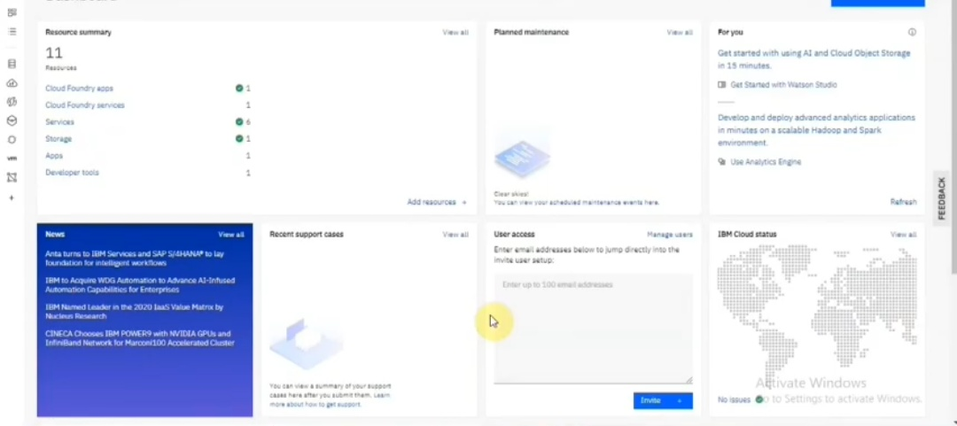
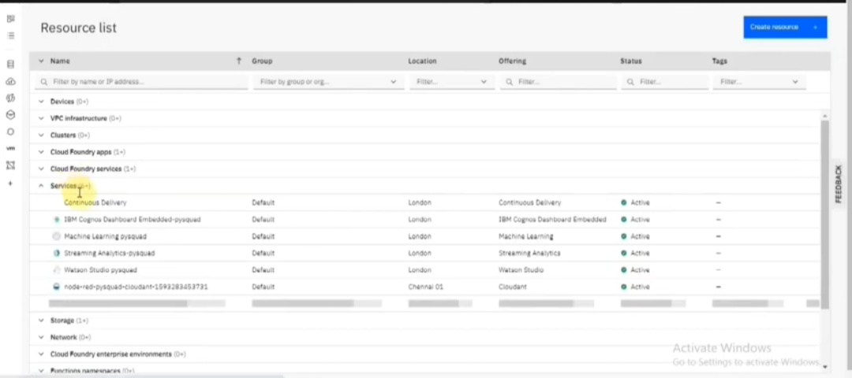
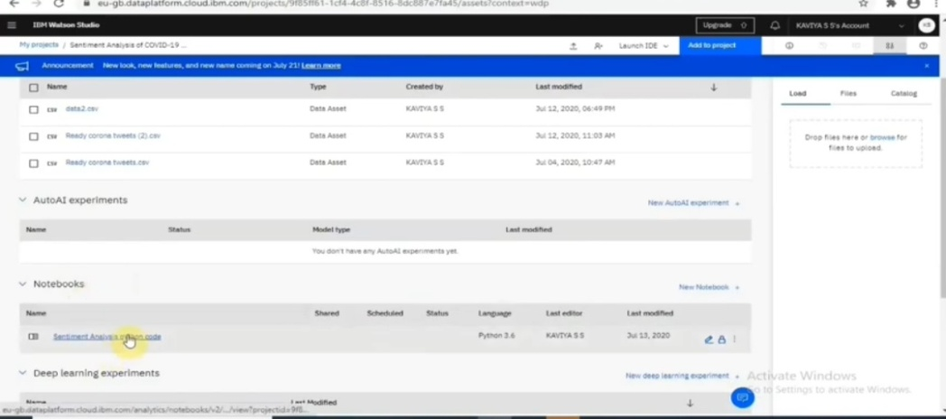
CLOUD & ITS SERVICES

Slide 7
PACKAGES
The packages imported are
Sklearn(open machine learning package)
Nltk(preprocess the text)
Pandas(work with datas)
Re(to find string set)
String(contain pre defined functions for strings)

Slide 8
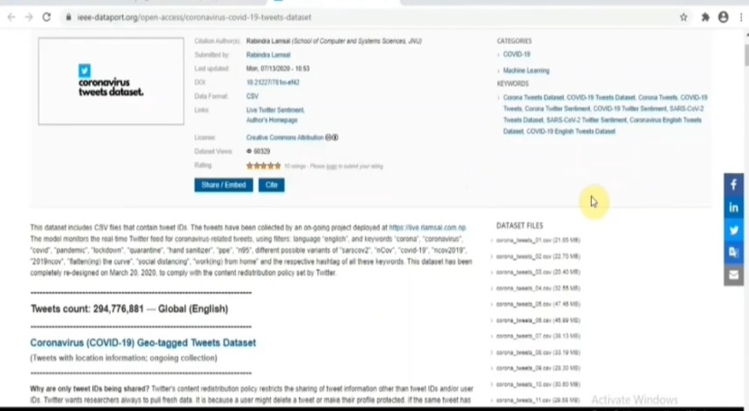
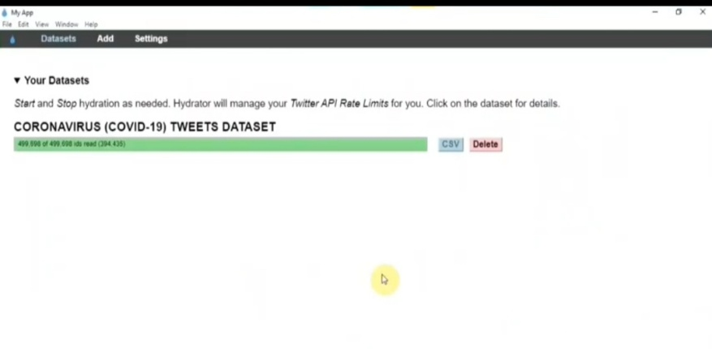
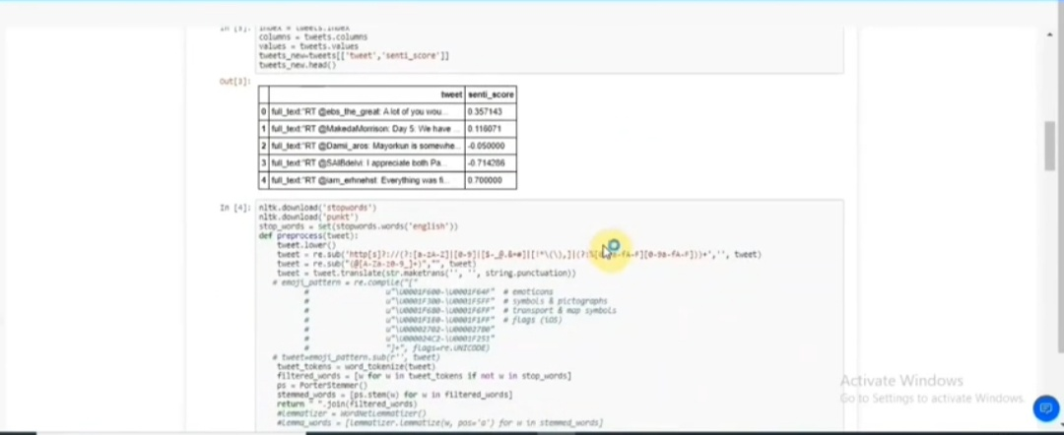
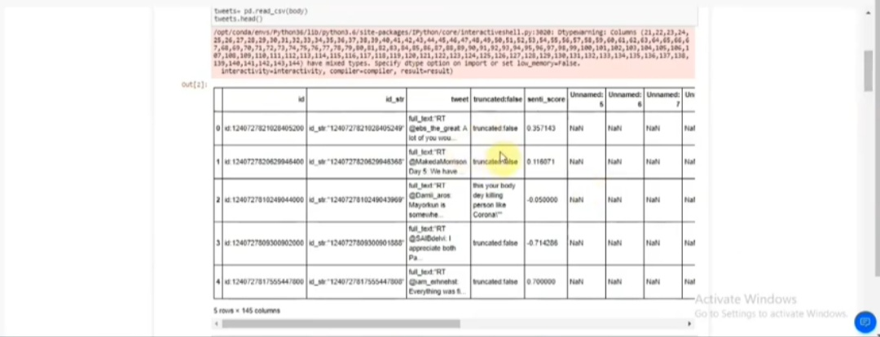
IMPORTING DATA SET & RESULT OBTAINED

Slide 9
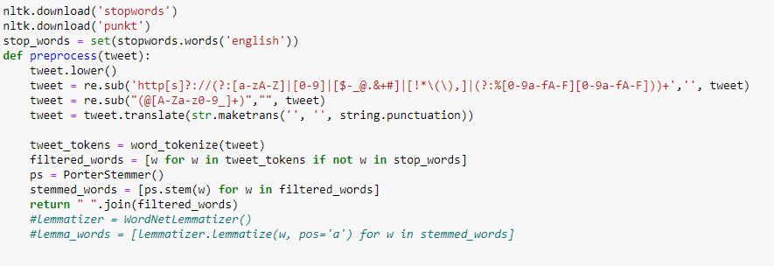
PREPROCESSING

Slide 10
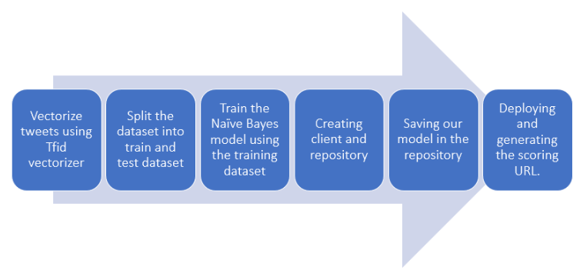
Training model and deployment

Slide 11

BUSINESS/ SOCIAL IMPACT:
Working with senses instead of words will enable government to visualize people’s accurate opinion.
Thereby government can be guided on taking better decisions.
Public’s postive attitude is most needed for fighting this pandemic.

Slide 12




NOVELTY/ UNIQUENESS
Code can work on large datasets and give results with good accuracy.
Usage of inbuilt python packages enables a lot of functions on the data set at an ease of access.
Data can be visualized graphically through the use of matlplot libraries.
Code is simple, effective and understandable.

Slide 13

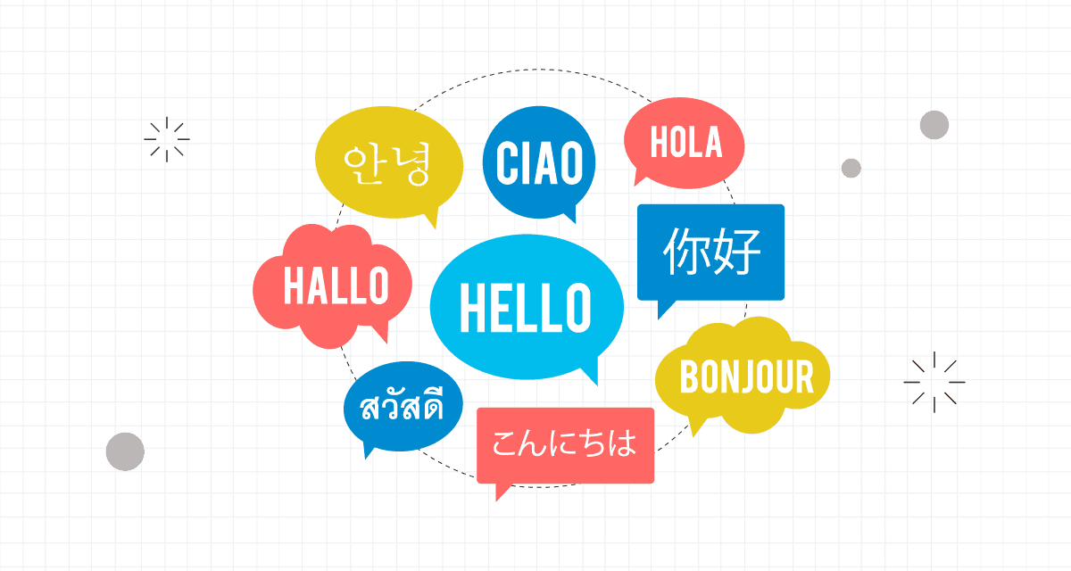

SCOPE
Through the use of Recurrent Neural Networks or Google Natural Language API, Code can also be implemented on Multilingual texts.
This code can also be experimented on product review to predict the like/dislike of a customer towards a Product.

